Slide 1
OO Concepts

Slide 2
Overview: OO Concepts
Background and Principles of Object Orientation
Object Oriented Concepts
Object Oriented Analysis (OOA)
Object Oriented Design (OOD)

Slide 3
The Road to OO
Procedural Paradigm
Modular Paradigm
Data Abstraction Paradigm
Object Oriented Paradigm

Slide 4
What is OO?
Definition
Object orientation is about viewing and modelling the world (or any system) as a set of interacting and interrelated objects.
An approach characterized by the following features:
views the universe of discourse as consisting of interacting objects
describes and builds systems consisting of representation of objects

Slide 5
Principles of OO
Abstraction
Encapsulation
Modularity
Hierarchy

Slide 6



Abstraction
A model that includes most important aspects of a given system while ignoring less important details.
Abstraction allows us to manage complexity by concentrating on essential characteristics that makes an entity different from others.
Salesman
Customer
An example of an order processing abstraction
Product

Slide 7

Encapsulation 1
Encapsulation separates implementation from users or clients.
Clients depend on interface.
Courtesy Rational Software

Slide 8
Modularity
Modularity deals with the process of breaking up complex systems into small, self contained pieces that can be managed easily.
Order Entry
Order Processing System
Order Fulfillment
Billing

Slide 9




Hierarchy
Is an ordering of abstractions into a tree like structure.
Asset
Increasing abstraction
Bank Account
Security
Real Estate
Savings
Checking Stock
Bond

Slide 10
UML

Slide 11
Overview
What is UML?
A brief history of UML and its origins.
Understanding the basics of UML.
UML diagrams
UML Modeling tools

Slide 12
What is UML?
UML: Unified Modeling Language
An industry-standard graphical language for specifying, visualizing, constructing, and documenting the artifacts of software systems, as well as for business modeling.
The UML uses mostly graphical notations to express the OO analysis and design of software projects.
Simplifies the complex process of software design

Slide 13
Why UML for Modeling?
A diagram/picture = thousands words
Uses graphical notation to communicate more clearly than natural language (imprecise) and code(too detailed).
Makes it easier for programmers and software architects to communicate.
Helps acquire an overall view of a system.
UML is not dependent on any one language or technology.
UML moves us from fragmentation to standardization.

Slide 14
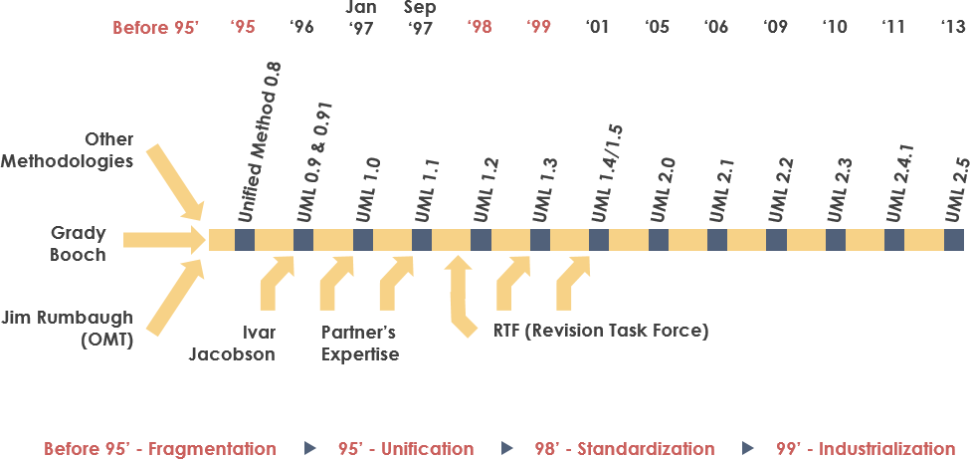
History
Time

Slide 15
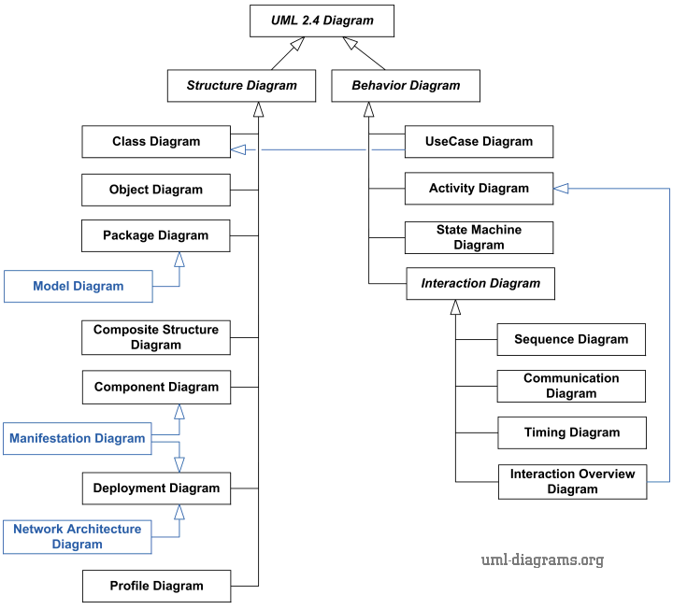

Slide 16
TYPES OF DIAGRAMS
Use case Diagrams
Describe the functional behavior of the system as seen by the user.
Class diagrams
Describe the static structure of the system: Objects, Attributes, Associations
Sequence diagrams
Describe the dynamic behavior between actors and the system and between objects of the system
Statechart diagrams
Describe the dynamic behavior of an individual object (essentially a finite state automaton)

Slide 17
Types of UML Diagrams (Cont.)
Activity Diagrams
Model the dynamic behavior of a system, in particular the workflow (essentially a flowchart)
Component Diagram
Illustrate the organizations and dependencies of the physical components in a system. A higher level than class diagrams.

Slide 18
Use Case Diagrams
Boundary
Use Case
Actor
Library System
Client
Borrow
Employee
Order Title
Fine Remittance
Supervisor
A generalized description of how a system will be used.
Provides an overview of the intended functionality of the system

Slide 19

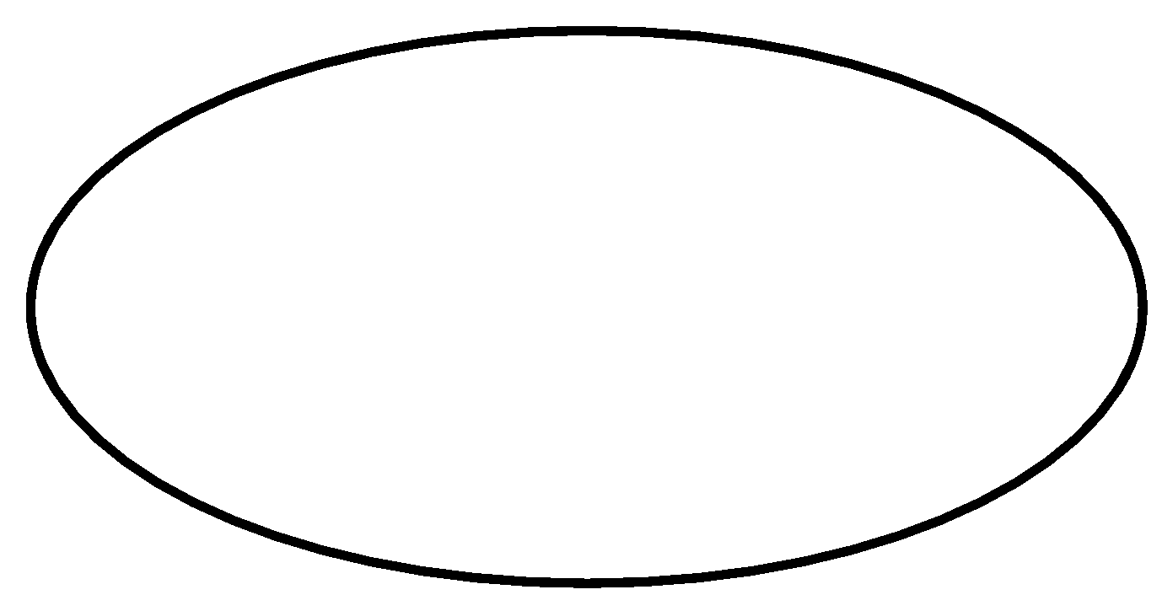
Use Case Diagram(core components)
Actors: A role that a user plays with respect to the system,including human users and other systems. e.g.,in animate physical objects (e.g. robot); an external system that needs some information from the current system.
An actor models an external entity which communicates with the system:
User
External system
Physical environment
Use case: set of scenarios that describing an interaction between a user and a system.

Slide 20
Use Case Diagram (core components)
A use case is a single unit of meaningful work. E.g. login, register, place an order, etc.
Each Use Case has a description which describes the functionality that will be built in the proposed system.
E.g. for use case “order title” , a brief description: This use case receives orders from employee or supervisor, then return the ordered title.
System boundary: a rectangle diagram representing the boundary between the actors and the system.

Slide 21

Use Case Diagram(core relationship)
Association: communication between an actor and a use case; represented by a solid line.
Generalization: relationship between one general use case and one specific use case.
Represented by a line with a triangular arrow head toward the parent use case, the more general modeling element.
waitress
employee

Slide 22
Use Case Diagram(core relationship)
Include: a dotted line labeled <<include>> beginning at base use case and ending with an arrows pointing to the include use case. An “Include” relationship is used to indicate that a particular Use Case must include another use case to perform its function.
<<include>>
A Use Case may be included by one or more Use Cases, so it reduces duplication of functionality.
Example: the <list orders> Use Case may be included
every time when the <modify order> Use Case is run.

Slide 23
Use Case Diagram (core relationship)
Extend: a dotted line labeled <<extend>> with an arrow toward the base case. The extending use case may add behavior to the base use case. The base class declares “extension points”.
<<extend>>
Used when exceptional circumstances are encountered. For example, the <get approval> Use Case may optionally extend the regular <modify order> Use Case.

Slide 24
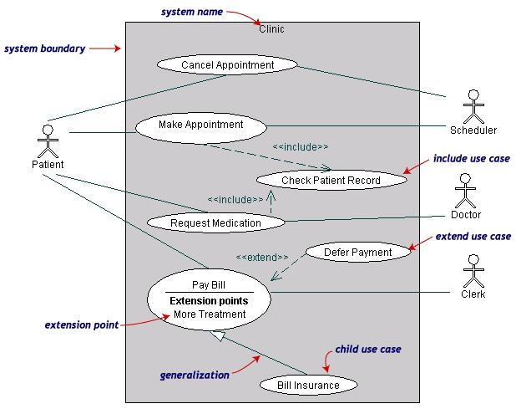
Use Case Diagrams(cont.)
Both Make Appointment and Request Medication include Check Patient Record as a subtask (include)
The extension point is written inside the base case Pay bill; the extending class Defer payment adds the behavior of this extension point. (extend)
Pay Bill is a parent use case and Bill Insurance is the child use case. (generalization)
(TogetherSoft, Inc)

Slide 25
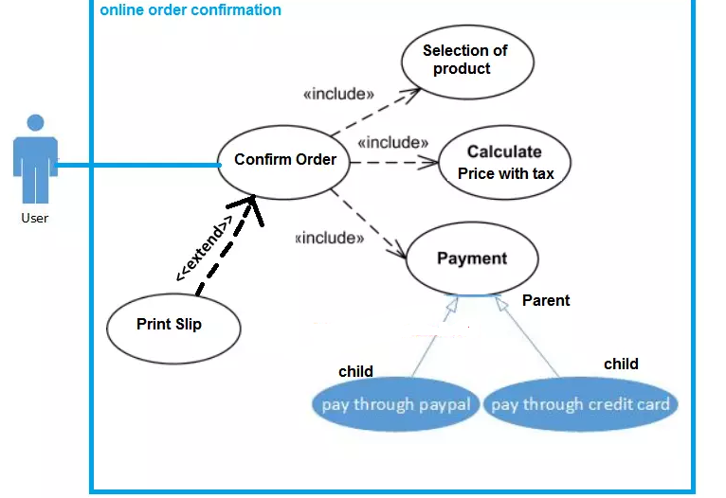

Slide 26
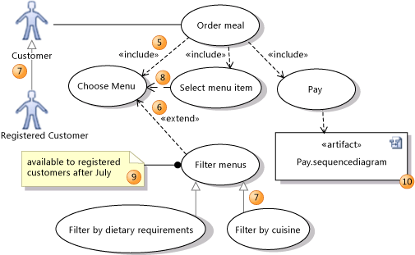

Slide 27
Class Diagram
Each class is represented by a rectangle subdivided into three compartments
Name
Attributes
Operations
Modifiers are used to indicate visibility of attributes and operations.
‘+’ is used to denote Public visibility (everyone)
‘#’ is used to denote Protected visibility (friends and derived)
‘-’ is used to denote Private visibility (no one)
By default, attributes are hidden and operations are visible.
The last two compartments may be omitted to simplify the class diagrams

Slide 28
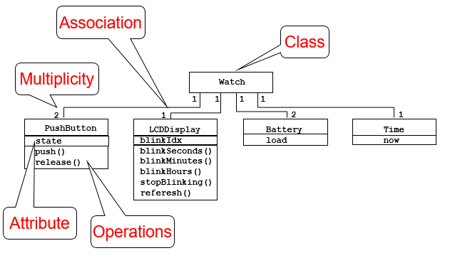
Class Diagram

Slide 29
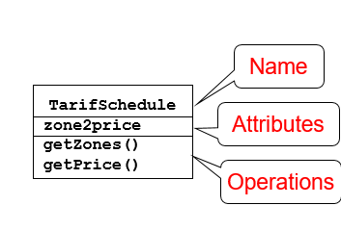
An example of Class

Slide 30
C++ Class Example
class Checking { private:
char Customer_name[20]; float Balance; public: AddFunds(float); WithDraw(float); Transfer(float);
set_name(string);
get_name();
set_balance(float);
get_balance();
};

Slide 31
Person
firstName lastName email
getName() getEmail() setEmail( ) equals( ) toString()
SocialNetwork
friendList numFriends DEFAULT_MAX_FRIENDS
add( ) remove() toString()

Slide 32
Relationships
There are two kinds of Relationships
Generalization (parent-child relationship)
Association (student enrolls in course)
Associations can be further classified as
Aggregation
Composition

Slide 33
Associations
Represent relationship between instances of classes
Student enrolls in a course
Courses have students
Courses have exams etc.
Association has two ends
Role names (e.g. enrolls)
Multiplicity (e.g. One course can have many students)
Navigability (unidirectional, bidirectional)

Slide 34
Notation of Class Diagram: association
Associations represent relationships between instances of classes .
An association is a link connecting two classes.
Bi-directional association Associations are assumed to be bi-directional
e.g. Flight and plane
notation:
Uni-directional association e.g. Order and item
notation:

Slide 35
Association: Multiplicity and Roles
student
1
*
University
Person
0..1
*
employer
teacher
Multiplicity
Symbol Meaning
1 One and only one
0..1 Zero or one
M..N From M to N (natural language)
* From zero to any positive integer
0..* From zero to any positive integer
1..* From one to any positive integer
Role
Role
“A given university groups many people; some act as students, others as teachers. A given student belongs to a single university; a given teacher may or may not be working for the university at a particular time.”

Slide 36
Notation of Class Diagram: Generalization
Supertype
Example:
Customer
Regular
Customer
Loyalty
Customer
Subtype1
Subtype2
or:
Customer
Generalization expresses a relationship among related classes. It is a class that includes its subclasses.
Regular
Customer
Loyalty
Customer

Slide 37
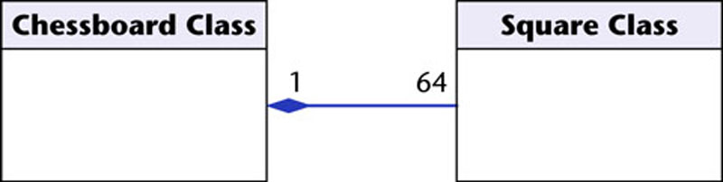
COMPOSITION
Whole Class
Class W
Automobile
Class P₁
Class P₂
Engine
Transmission
Part Classes
Example
Notation of Class Diagram: Composition

Slide 38
Notation of Class Diagram: Composition
Composition: expresses a relationship among instances of related classes. It is a specific kind of Whole-Part relationship.
It expresses a relationship where an instance of the Whole-class has the responsibility to create and initialize instances of each Part-class. It may also be used to express a relationship where instances of the Part-classes have privileged access or visibility to certain attributes and/or behaviors defined by the Whole-class. Composition should also be used to express relationship where instances of the Whole-class have exclusive access to and control of instances of the Part-classes. Composition should be used to express a relationship where the behavior of Part instances is undefined without beingrelated to an instance of the Whole. And, conversely, the behavior of the Whole is ill-defined or incomplete if one or more of the Part instances are undefined.

Slide 39
Notation of Class Diagram: Aggregation
Container Class
Class C
AGGREGATION
Class E₁
Class E₂
Containee Classes
Example
Bag
Apples
Milk

Slide 40
Aggregation
Aggregation: expresses a relationship among instances of related classes. It is a specific kind of Container-Containee relationship.
It expresses a relationship where an instance of the Container-class has the responsibility to hold and maintain instances of each Containee-class that have been created outside the auspices of the Container-class. Aggregation should be used to express a more informal relationship than composition expresses. That is, it is an appropriate relationship where the Container and its Containees can be manipulated independently.
Aggregation is appropriate when Container and Containees have no special access privileges to each other.

Slide 41
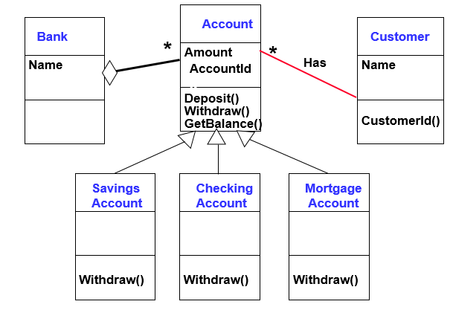

Slide 42
Aggregation vs. Composition
Composition is really a strong form of aggregation
components have only one owner
components cannot exist independent of their owner;
both have coincident lifetimes
components live or die with their owner
e.g. (1)Each car has an engine that can not be shared
with other cars.
(2) If the polygon is destroyed, so are the points.
Aggregations may form "part of" the aggregate, but may not be essential to it. They may also exist independent of the aggregate. Less rigorous than a composition.
e.g. (1)Apples may exist independent of the bag.
(2)An order is made up of several products, but the
products are still there even if an order is
cancelled.

Slide 43
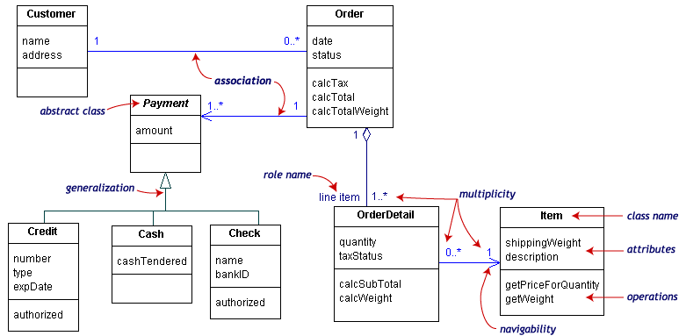
UML Class Example

Slide 44
Interaction Diagrams
OBJECT INTERACTION DIAGRAM
UML sequence diagram represent behavior in terms of interactions.
Useful to find missing objects.
Time consuming to build but worth the investment.
Complement the class diagrams (which represent structure).
Interaction diagrams are dynamic -- they describe how objects collaborate.
A Sequence Diagram:
Indicates what messages are sent and when
Time progresses from top to bottom
Objects involved are listed left to right
Messages are sent left to right between objects in sequence

Slide 45
Sequence Diagram Format
Passenger
TicketMachine
Used during requirements analysis
To refine use case descriptions
to find additional objects (“participating objects”)
Used during system design
to refine subsystem interfaces
Classes are represented by columns
Messages are represented by arrows
Activations are represented by narrow rectangles
Lifelines are represented by dashed lines
selectZone()
insertCoins()
pickupChange()
pickUpTicket()

Slide 46
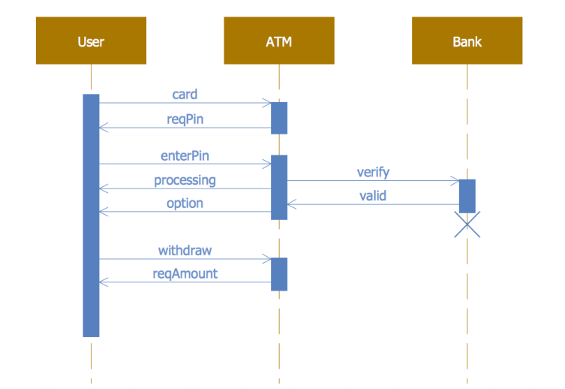
EXAMPLE

Slide 47
STUDENT CLASSROOM PORTAL
REQUIREMENTS
LOGIN
VALIDATION IN DATABASE
ROUTES TO CLASSROOM
ATTENDANCE FORM

Slide 48
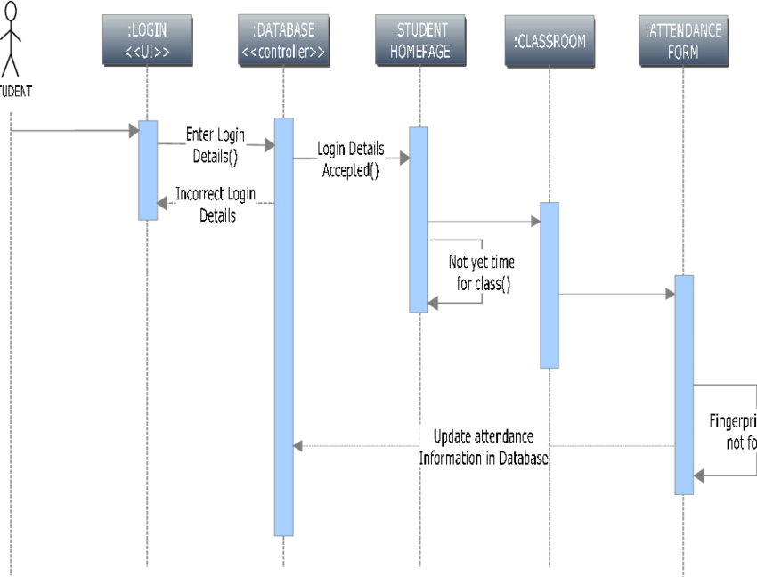

Slide 49
Components
Actors
Lifelines
Messages :
Synchronous messages
Asynchronous Messages,
Create message,
Delete Message ,
Self Message ,
Reply Message

Slide 50
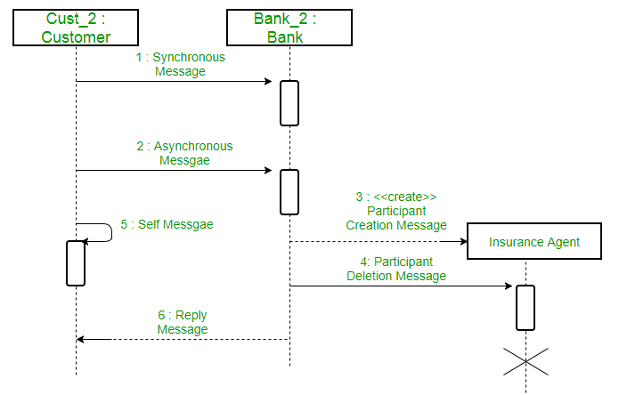

Slide 51
Example: Emotion based music player:
Firstly the application is opened by the user.
The device then gets access to the web cam.
The webcam captures the image of the user.
The device uses algorithms to detect the face and predict the mood.
It then requests database for dictionary of possible moods.
The mood is retrieved from the database.
The mood is displayed to the user.
The music is requested from the database.
The playlist is generated and finally shown to the user.

Slide 52
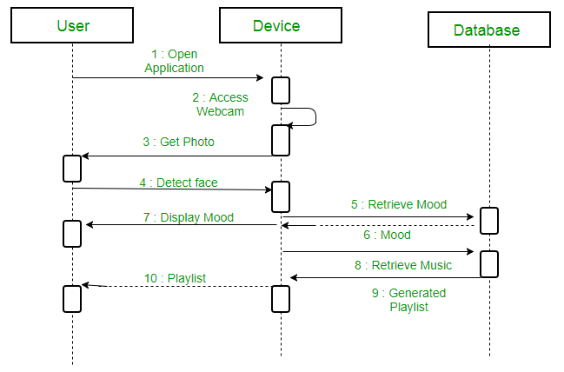

Slide 53
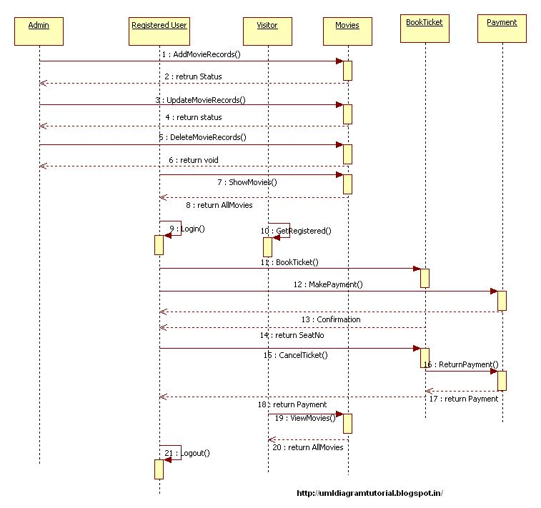

Slide 54
State Diagrams
State Diagrams show the sequences of states an object goes through during its life cycle in response to stimuli, together with its responses and actions; an abstraction of all possible behaviors.
Start
End
Unpaid
Paid
Invoice created
paying
Invoice destroying

Slide 55
Basic rules for State Diagrams
Draw only one object's chart at a time.
A state is drawn as a box with rounded corners.
From each state draw an arrow to another state if the object can change from one to the other in one step.
Label the arrow with the event that causes it.
Show the initial state by drawing an arrow from a black filled circle to the initial state.
Show the end state by drawing an arrow to a circle with a filled circle inside it.

Slide 56
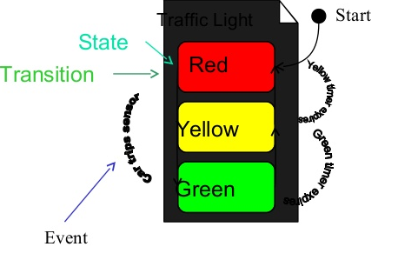

Slide 57
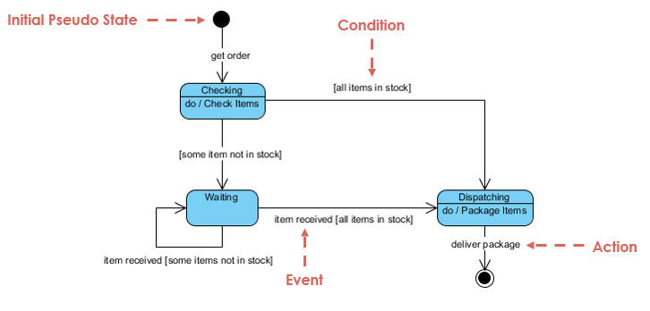
state diagram, state machine or state chart

Slide 58
Here is just an example of how an online ordering system might look like :
On the event of an order being received, we transit from our initial state to Unprocessed order state.
The unprocessed order is then checked.
If the order is rejected, we transit to the Rejected Order state.
If the order is accepted and we have the items available we transit to the fulfilled order state.
However if the items are not available we transit to the Pending Order state.
After the order is fulfilled, we transit to the final state. In this example, we merge the two states i.e. Fulfilled order and Rejected order into one final state.

Slide 59
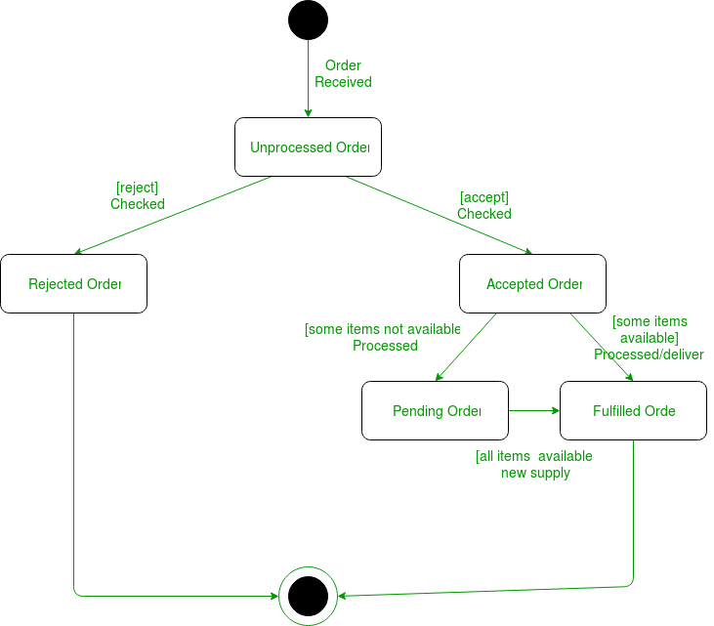
State Diagrams

Slide 60
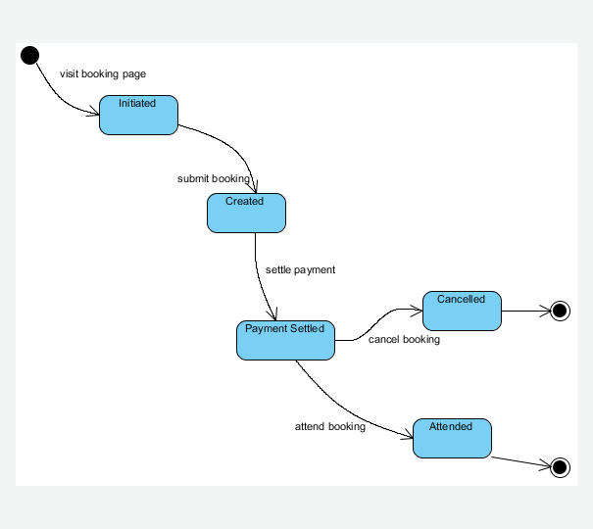
State Diagrams for a booking page

Slide 61
Activity Diagrams
Fancy flowchart
Displays the flow of activities involved in a single process
States
Describe what is being processed
Indicated by boxes with rounded corners
Swim lanes
Indicates which object is responsible for what activity
Branch
Transition that branch
Indicated by a diamond
Start and End

Slide 62
Fork. A black bar with one flow going into it and several leaving it. This denotes the beginning of parallel activity.
Join. A black bar with several flows entering it and one leaving it. All flows going into the join must reach it before processing may continue. This denotes the end of parallel processing. DF
Merge. A diamond with several flows entering and one leaving. The implication is that one or more incoming flows must reach this point until processing continues, based on any guards on the outgoing flow.
A guard is a condition that must be true in order to traverse a transition.

Slide 63
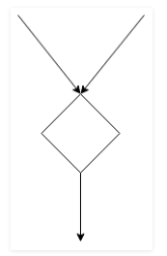
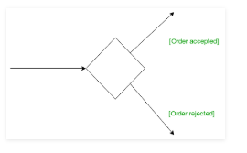
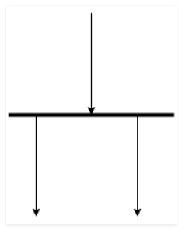
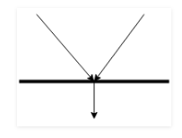
GUARD
MERGE
FORK
JOIN

Slide 64
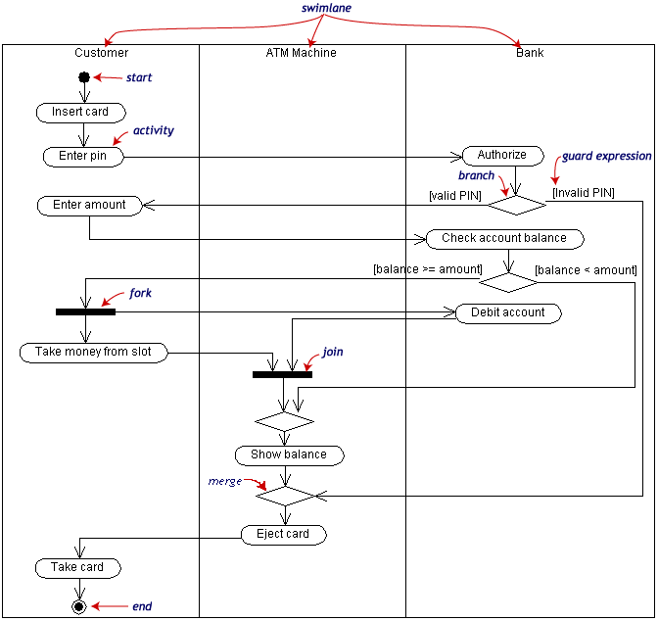
Activity Diagram Example

Slide 65
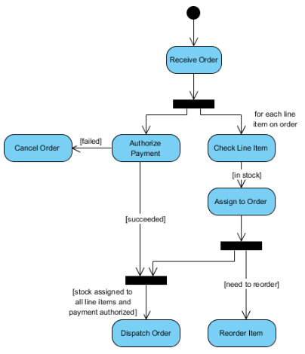
Sample Activity Diagram In an organization on receiving an order, how order is dispatched.

Slide 66
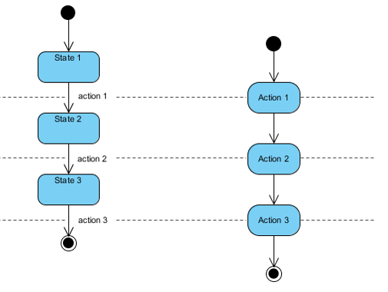
The figure below shows a comparison of a state diagram with a flowchart. A state machine diagram in the Figure on the left below performs actions in response to explicit events. In contrast, the Activity diagram in the Figure of the right below does not need explicit events but rather transitions from node to node in its graph automatically upon completion of activities.

Slide 67

Component Diagram
Illustrate the organizations and dependencies of the physical components in a system.
Has a higher level of abstraction than a Class diagram - usually implemented by one or more classes.
Symbols and Notations
Components
A component is a logical unit block of the system, a slightly higher abstraction

Slide 68
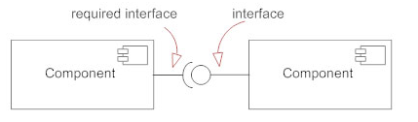
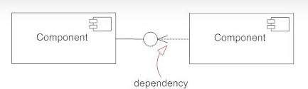
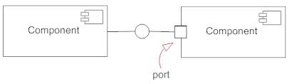
Interface: (small circle or semi-circle on a stick) describes a group of operations used (required) or created (provided) by components.
Dependencies: dependencies among components using dashed arrows.
A port is often used to help expose required and provided interfaces of a component.

Slide 69
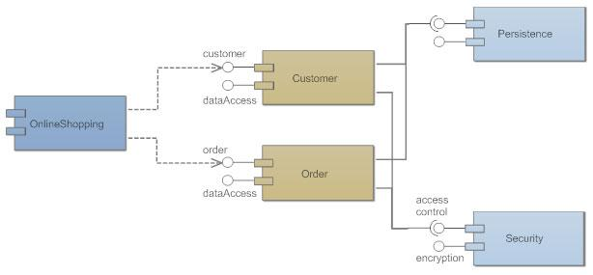
Component Diagram

Slide 70
UML Modeling Tools
Rational Rose (www.rational.com) by IBM
UML Studio 7.1 ( http://www.pragsoft.com/) by Pragsoft Corporation
Capable of handling very large models (tens of thousands of classes). Educational License US$ 125.00; Freeware version.
Microsoft Visio
Dia: open source, much like visio. (http://www.gnome.org/projects/dia/)
ArgoUML (Open Source; written in java ) (http://www.apple.com/downloads/macosx/development_tools/argouml.html )
Others (http://www.objectsbydesign.com/tools/umltools_byCompany.html )

Slide 71
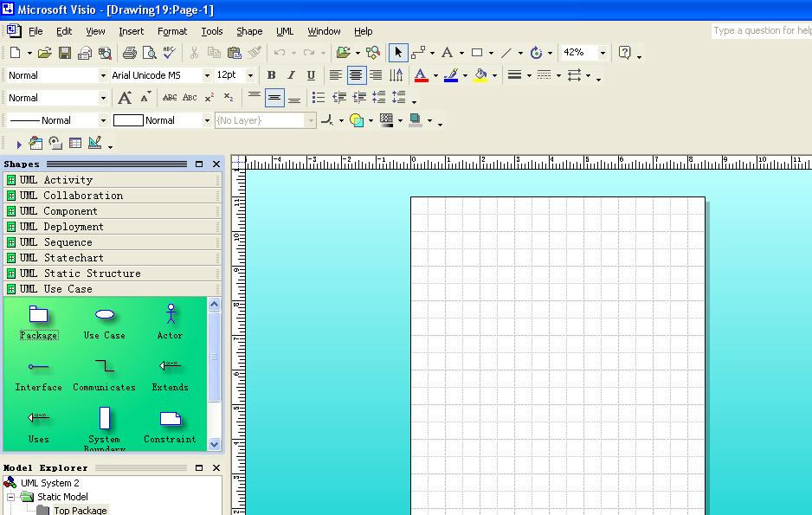
Microsoft Visio

Slide 72
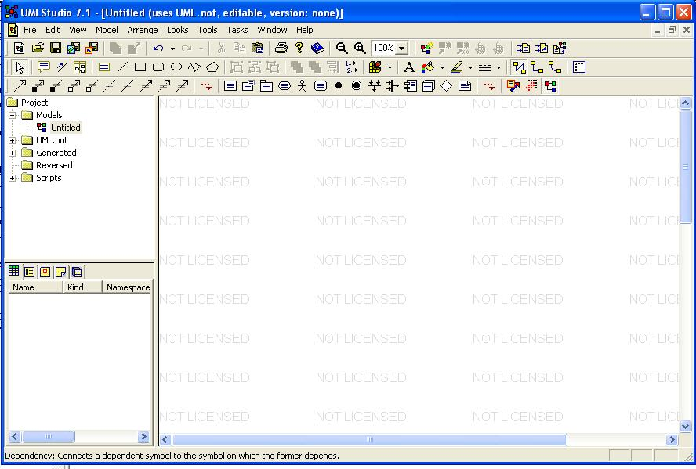
UML studio 7.1

Slide 73
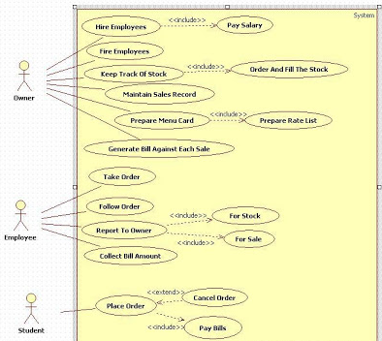
EXAMPLE ONLINE CANTEEN MANAGEMENT

Slide 74
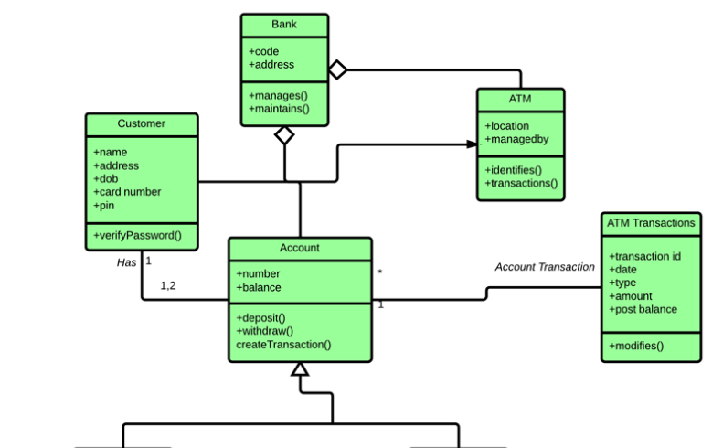
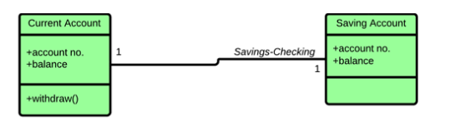
BANK PORTAL

Slide 75
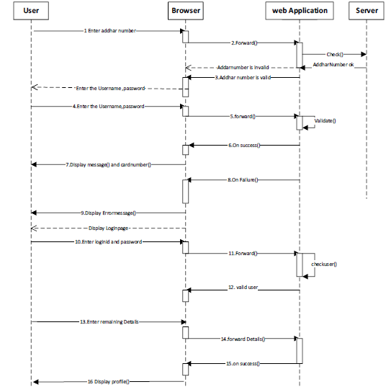
ONLINE TOLL PLAZA PORTAL

Slide 76
